Slide 1
SCHOOL : SCOPE
Project title :ROAD SAFETY APPLICATION
Course code : CSE3001
Course name : software engineering
Project by:
P VIJAY NARASIMHA REDDY - 19BCE2425
D CHIRANJEEVI - 19BCE2429
S SAI LOKESH - 19BCE2379
Submitted to : Prof. shashank mouli satapathy

Slide 2
Invdividual contribution
Login page - vijay
Sign up page ,Forgot password - vijay
Home page - Chiranjeevi
Feedback - Lokesh
Sqlite3 Database – Lokesh
Hospital json data - vijay
Traffic report - Chiranjeevi
Traffic view - Chiranjeevi
Accident report - Lokesh
Update accident - vijay
Email system ,Finding user location - vijay

Slide 3
OBJECTIVES
• If any person report about any traffic jam in any location that will be visible to all users, so they can avoid that route
• The app will provide facility to report accidents, after reporting immediately nearby ambulance driver will be sent location without any delay.
• After ambulance visit the accident area, this application will show the route for hospital
• The route the ambulance is following will be sent to all traffic police , so police in that route can clear way in advance
• People can give feedback and suggestions through application for further improvements.

Slide 4
OUR APPLICATION USER INTERFACE

Slide 5
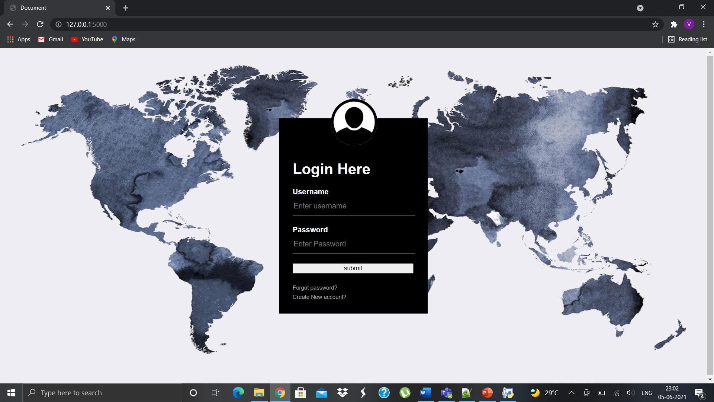
Login page

Slide 6
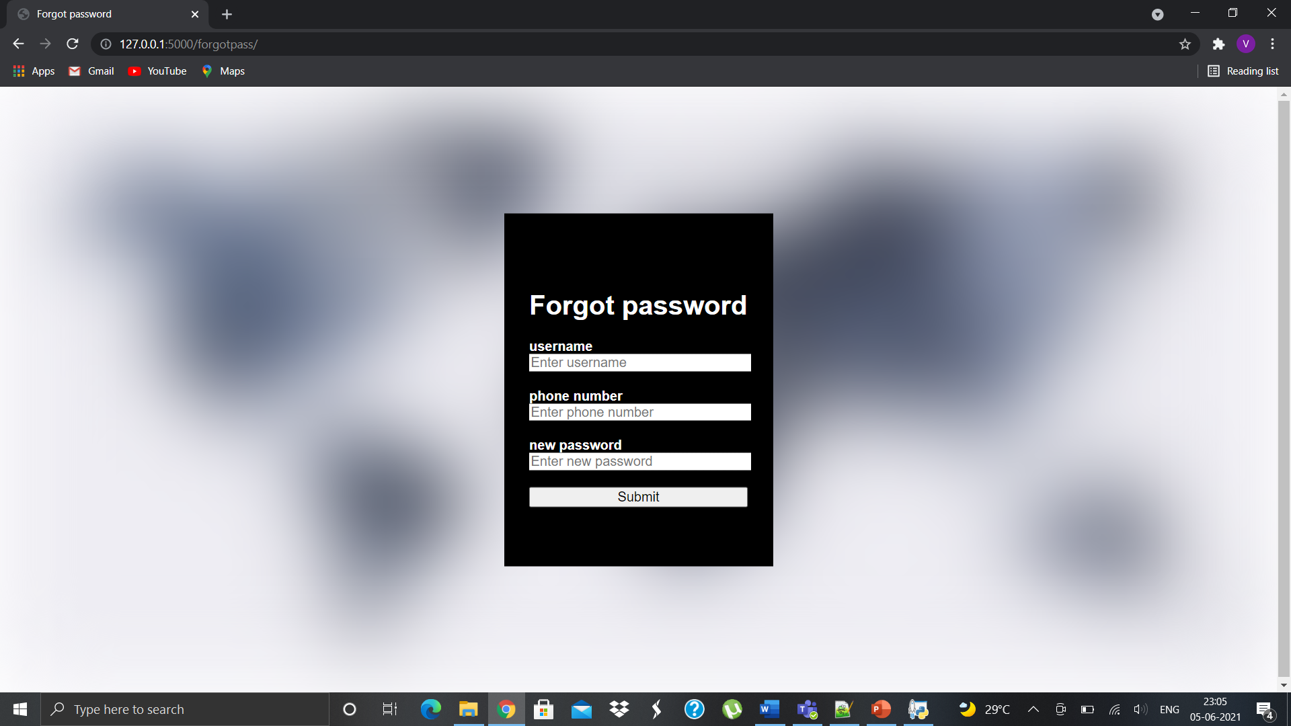
Forgot password page

Slide 7
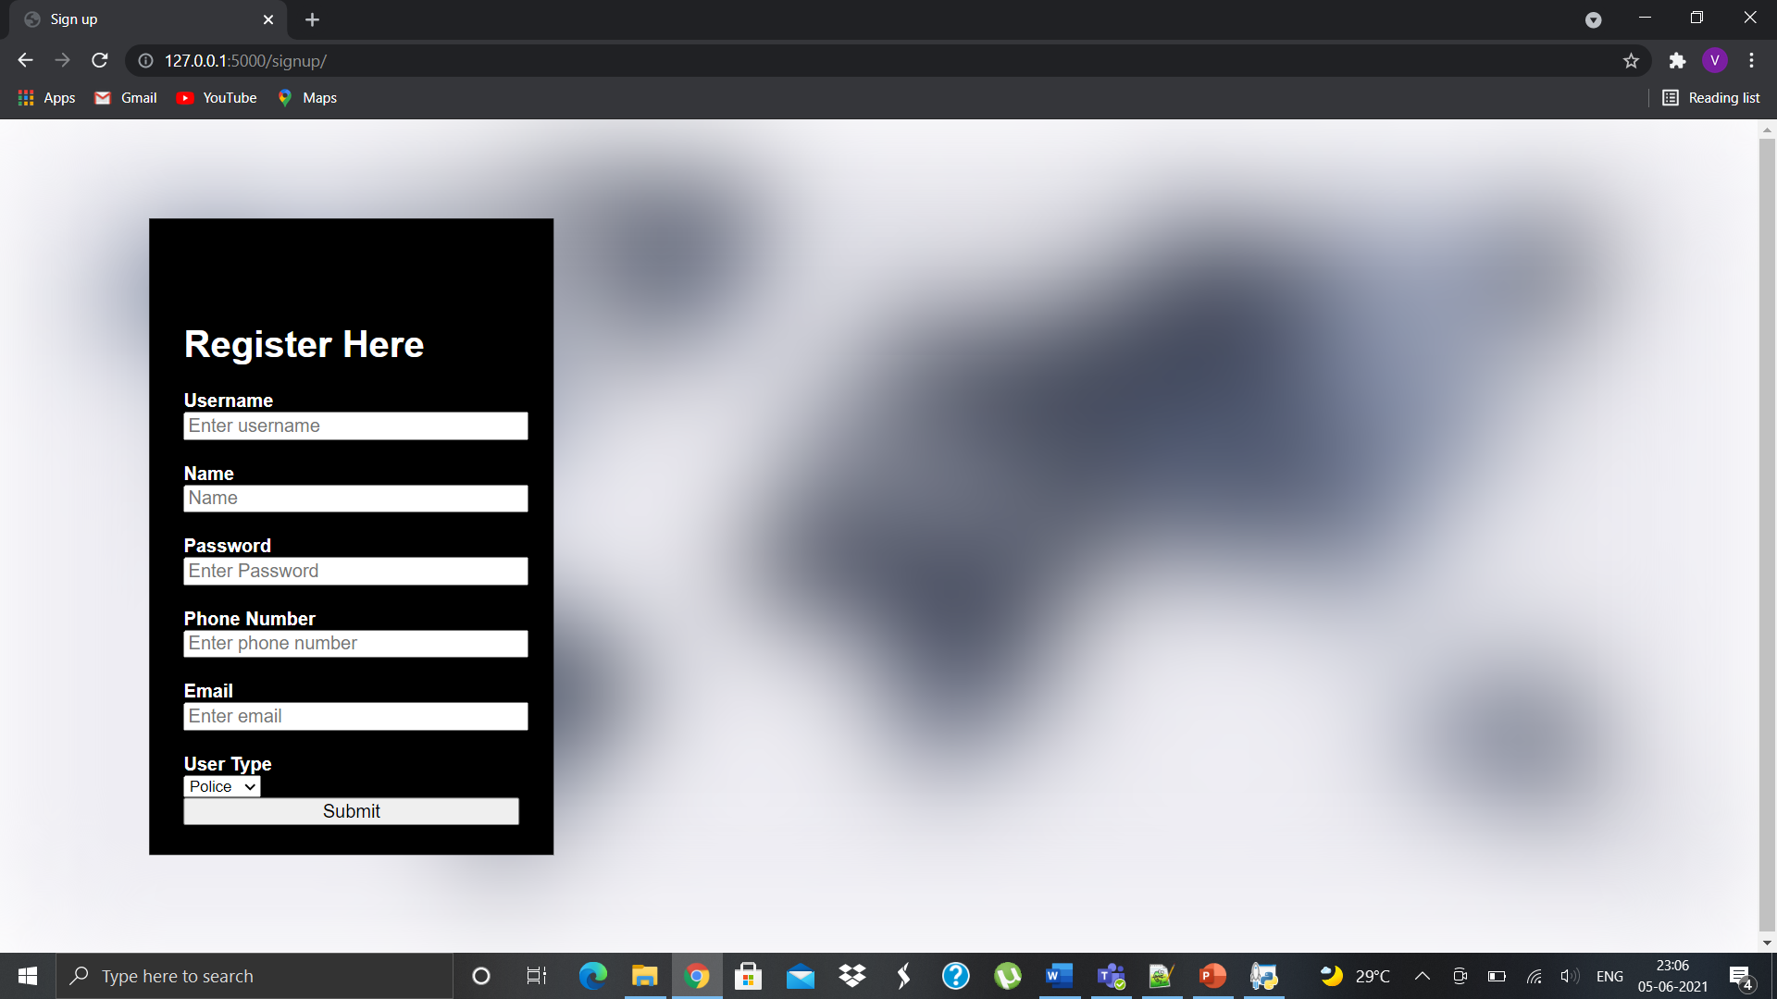
Sign up page

Slide 8
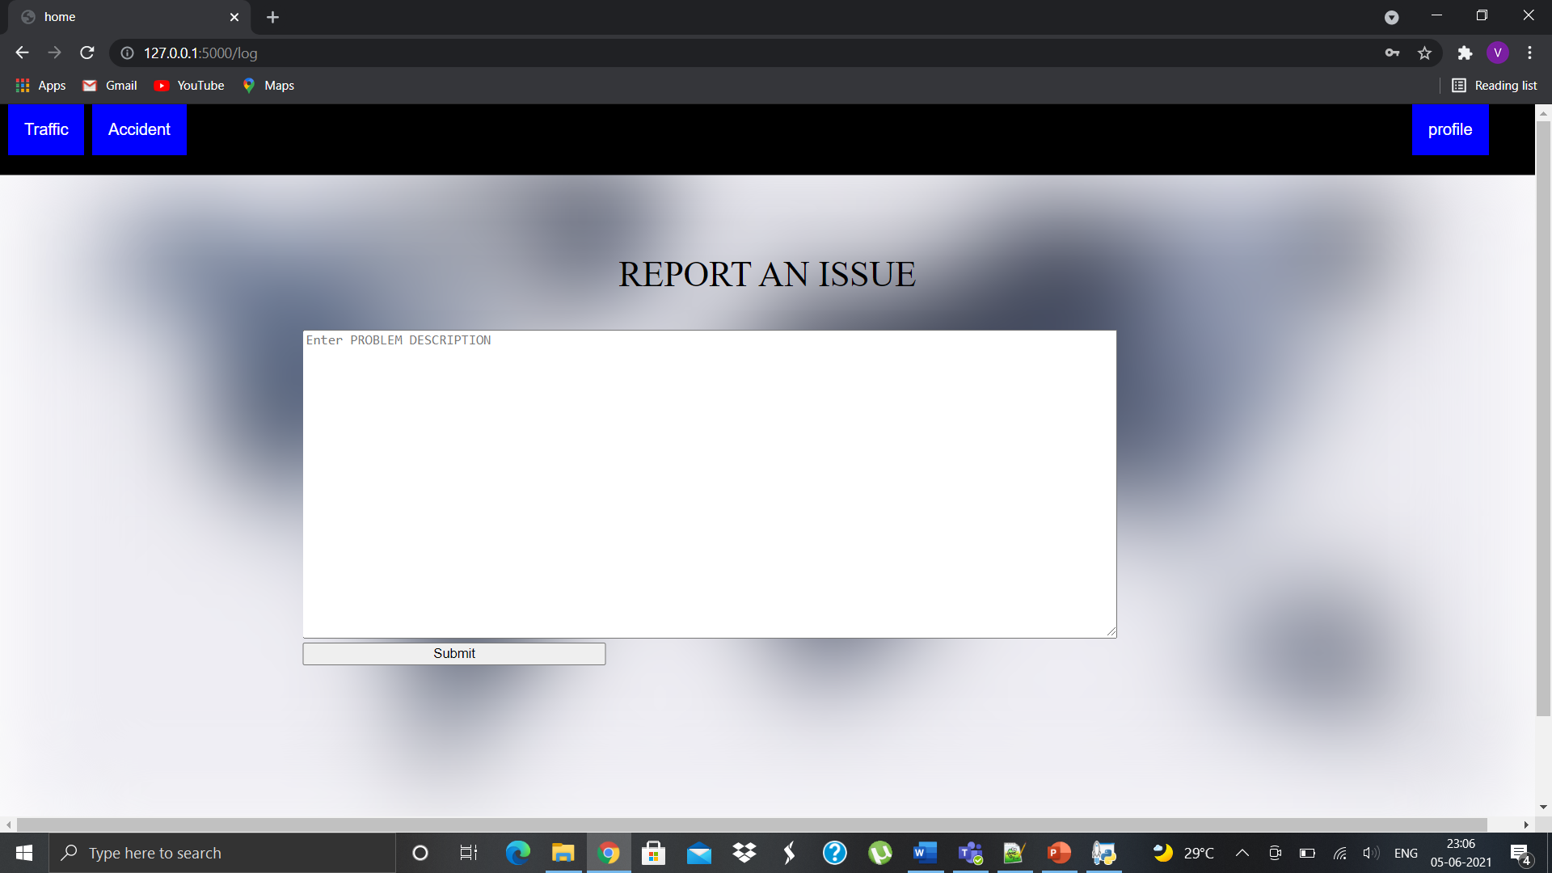
home page

Slide 9
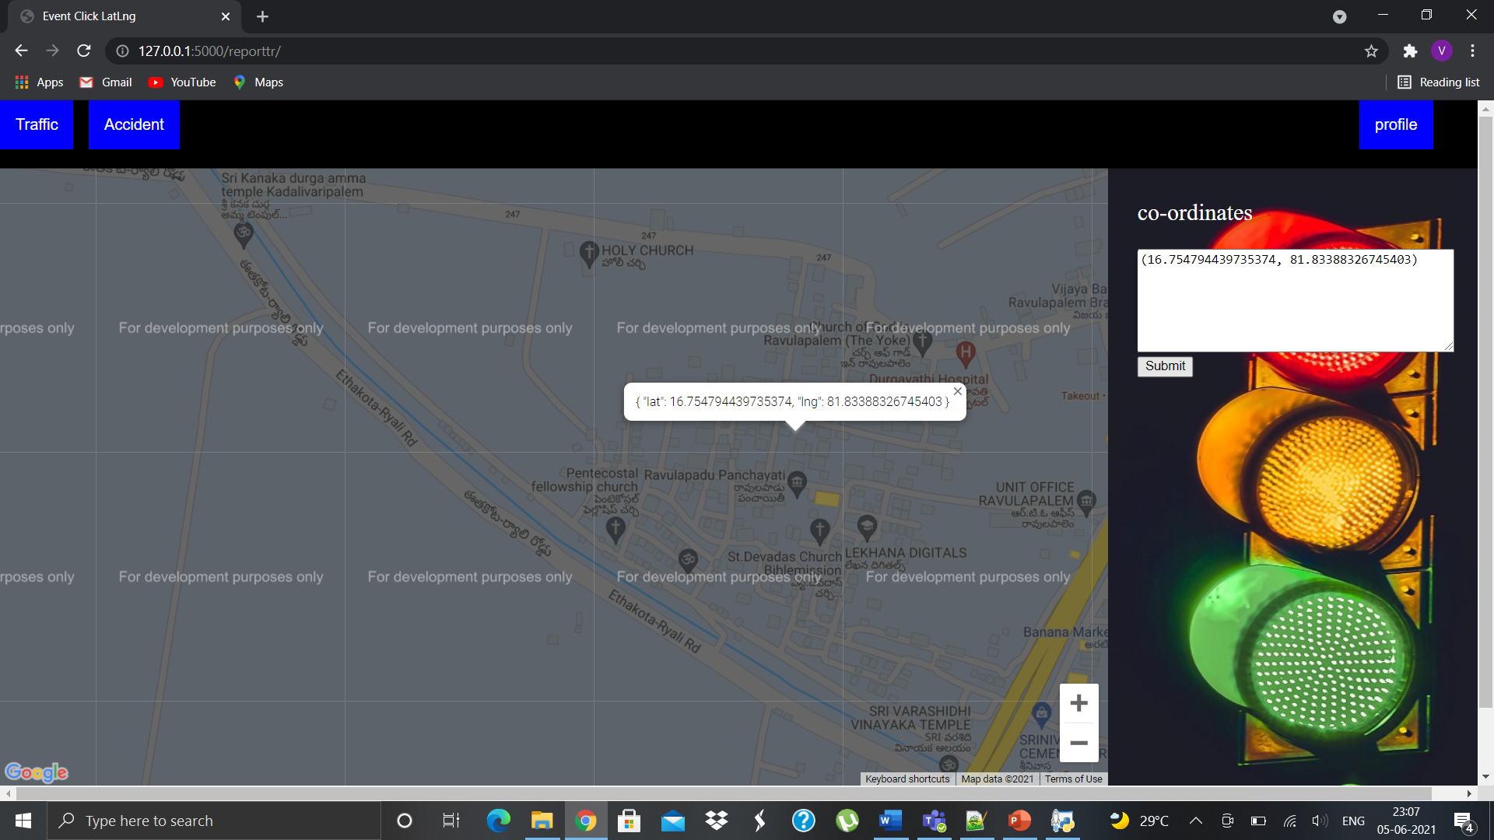
Traffic report page

Slide 10
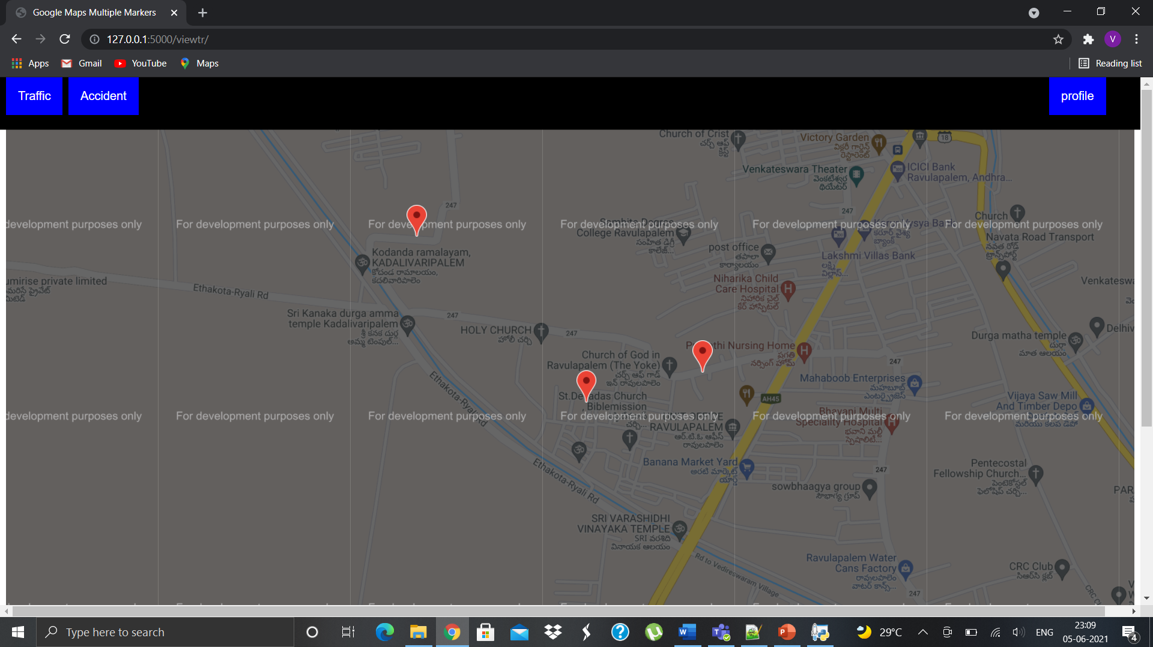
Traffic view page

Slide 11
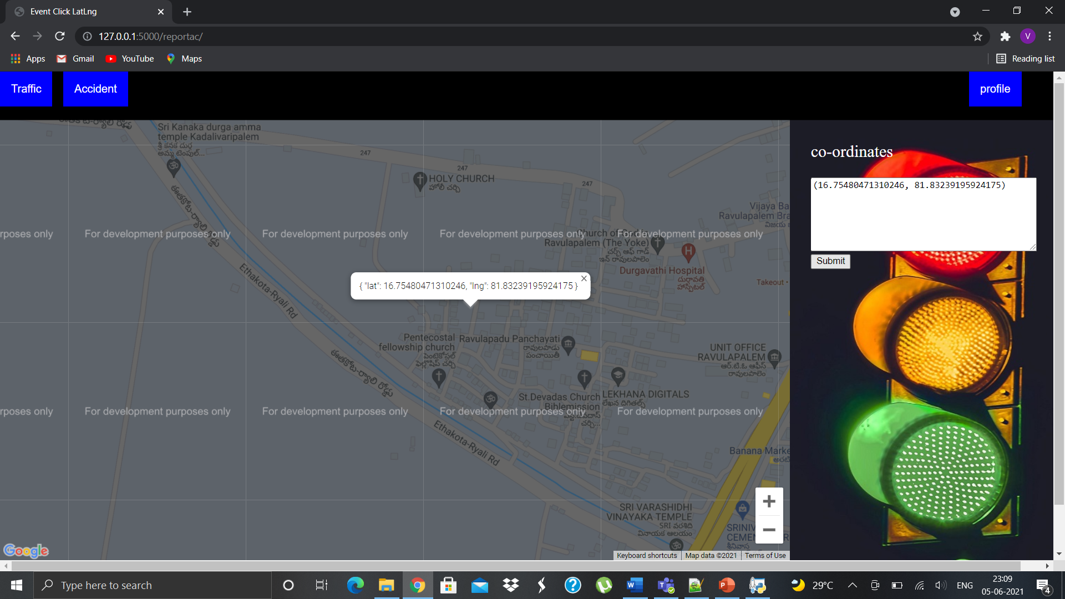
Accident report page

Slide 12
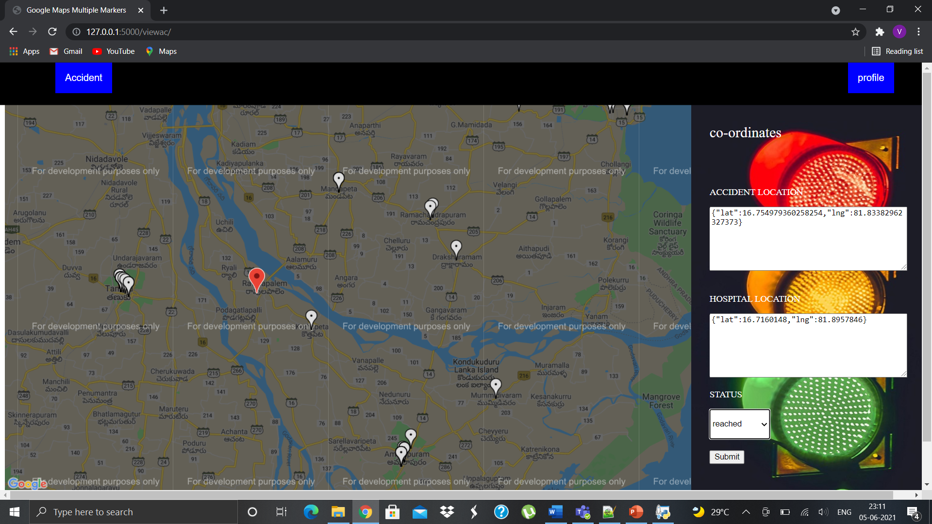
Accident view page

Slide 13
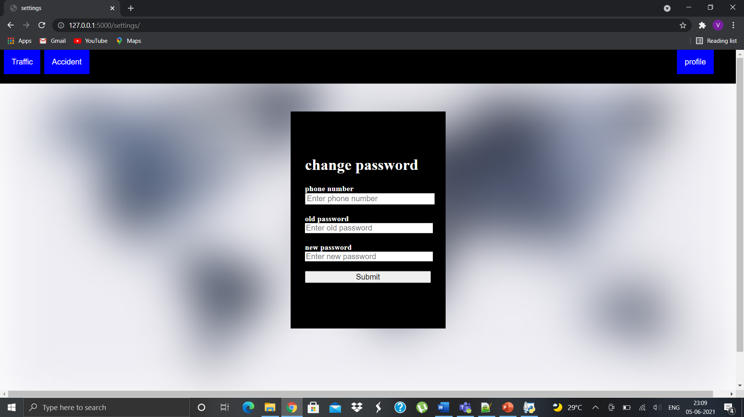
settings page

